Slide 1
Fast Separation of Direct and Global Images
Nayar, Krishnan, Grossberg, and Raskar
SIGGRAPH ‘06
Project website: www.cs.columbia.edu/CAVE/projects/separation/

Slide 2
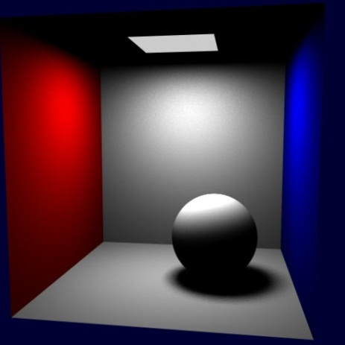
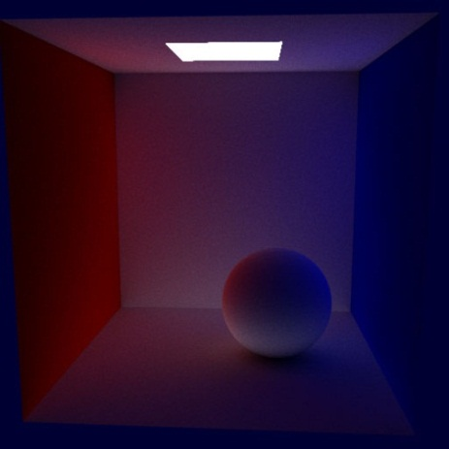
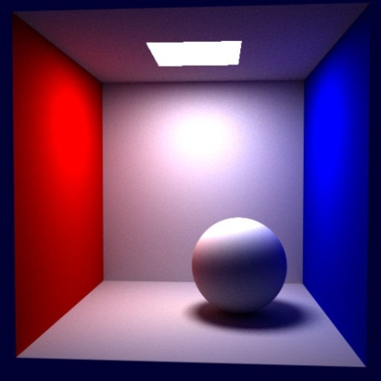
Global Illumination
+
=
Direct illumination
Indirect illumination
Total illumination

Slide 3
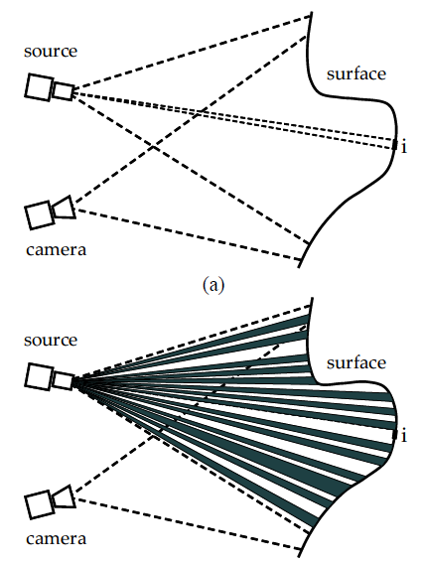
How to separate direct and indirect components (1/3)
Use a high frequency illumination pattern
For example a checkerboard pattern of lit and unlit patches
Each patch i that is not directly illuminated by the pattern should be lit due only to indirect illumination
This gives an estimate for indirect illumination on patch i

Slide 4
How to separate direct and indirect components (2/3)
Then how do we estimate indirect illumination for patches that fall in a directly illuminated region?
Light the scene by the complement of the original illumination pattern
e.g., all lit squares in the checkerboard become unlit, and all unlit squares become lit
Obtain estimate for direct illumination by subtracting the estimate for indirect illumination

Slide 5
How to separate direct and indirect components (3/3)
In theory, a high frequency pattern and its complement are sufficient for separation.
In practice, however, a series of images are used, each with the illumination pattern shifted slightly.
This technique can be applied to real life scenes
use a projector to cast a shifting high frequency pattern and take multiple photographs
is a technique from computer vision in that we are processing data captured from the real world
Different illumination patterns can be used
Checkerboard, sinusoidal pattern, line occluder passes a narrow linear shadow across the scene
Can produce impossible images which cannot be observed in the real world— adjust the blending ratio between indirect and direct illumination components

Slide 6
Video
http://www.cs.columbia.edu/CAVE/projects/separation/videos/Separation.mov

Slide 7
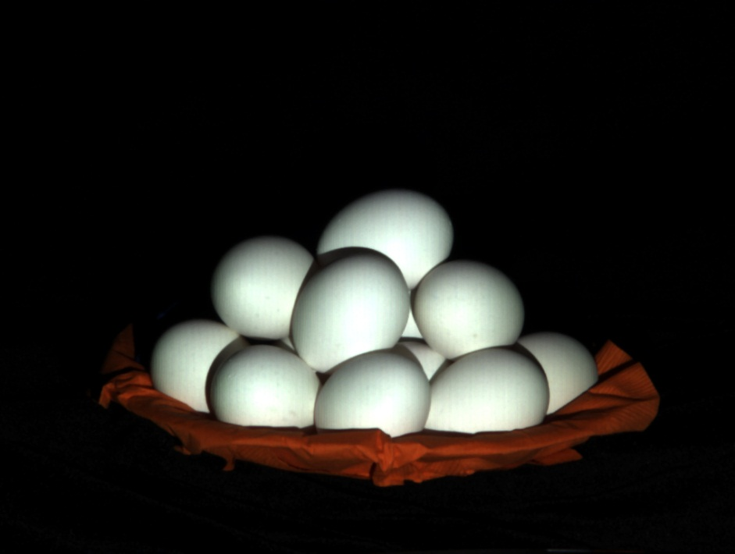
Diffuse Interreflection
Total illumination (normal image)

Slide 8
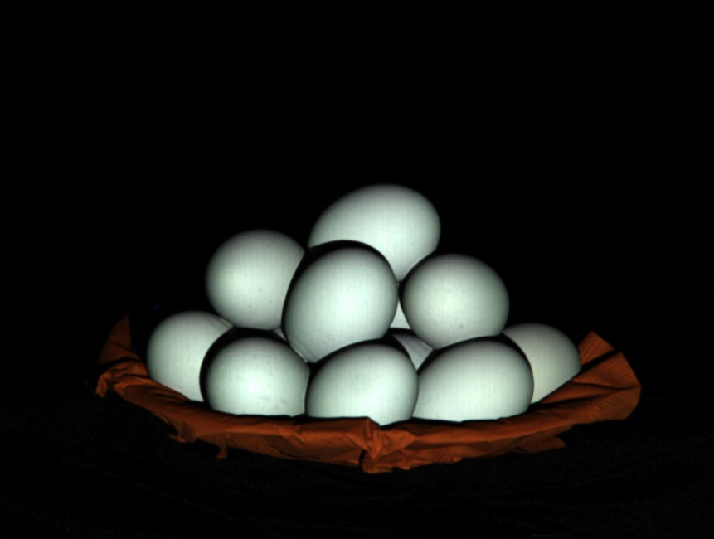
Diffuse Interreflection
Direct illumination

Slide 9
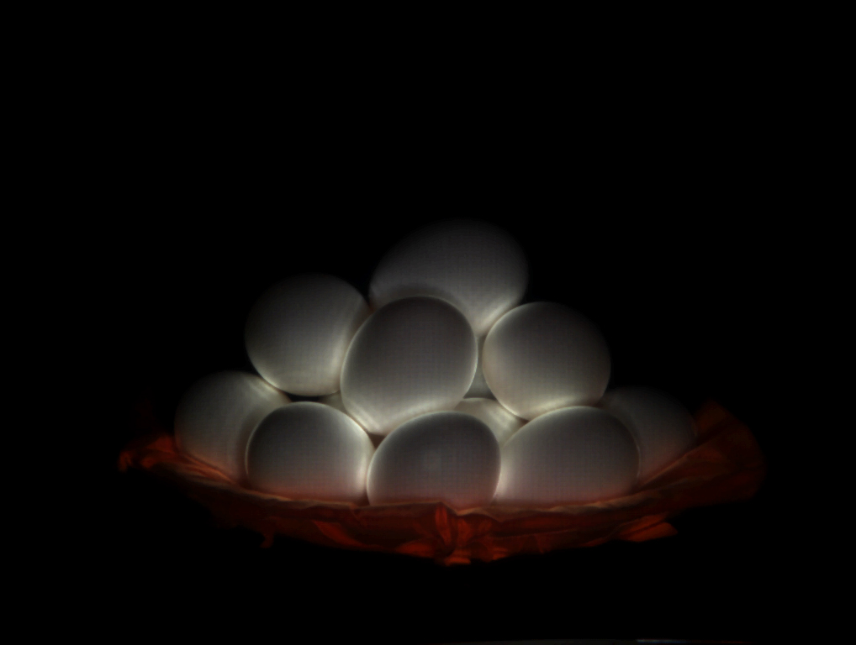
Diffuse Interreflection
Indirect illumination (diffuse interreflection)

Slide 10
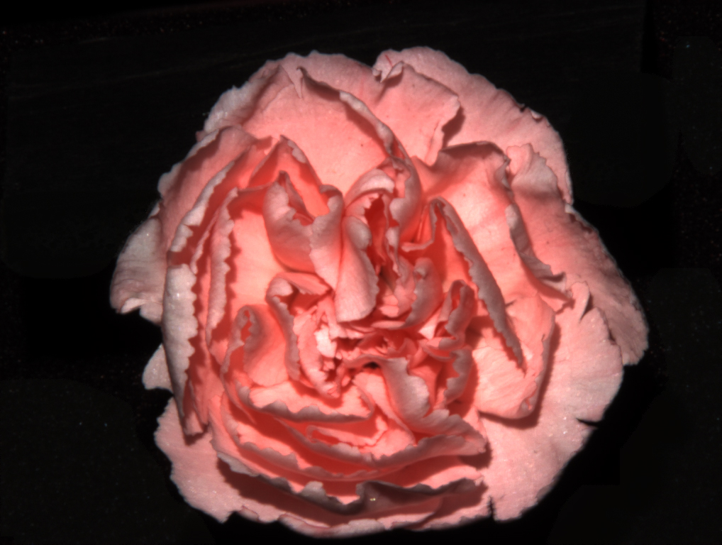
Rose
Total illumination (normal image)

Slide 11
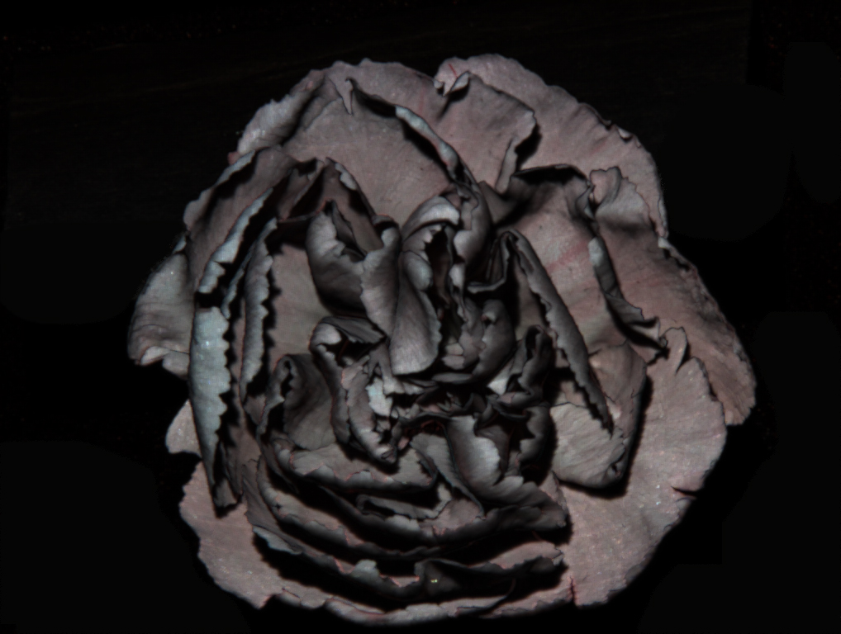
Rose
Direct illumination

Slide 12
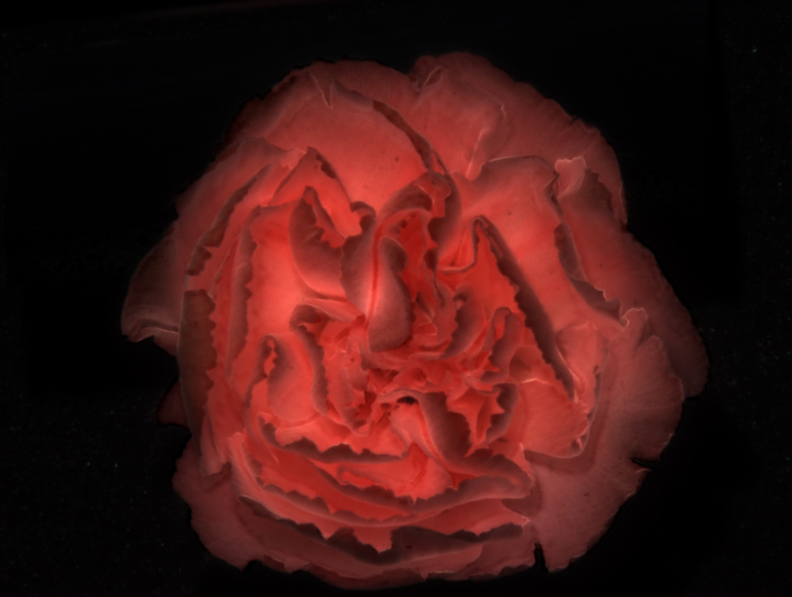
Rose
Indirect illumination (subsurface scattering)

Slide 13
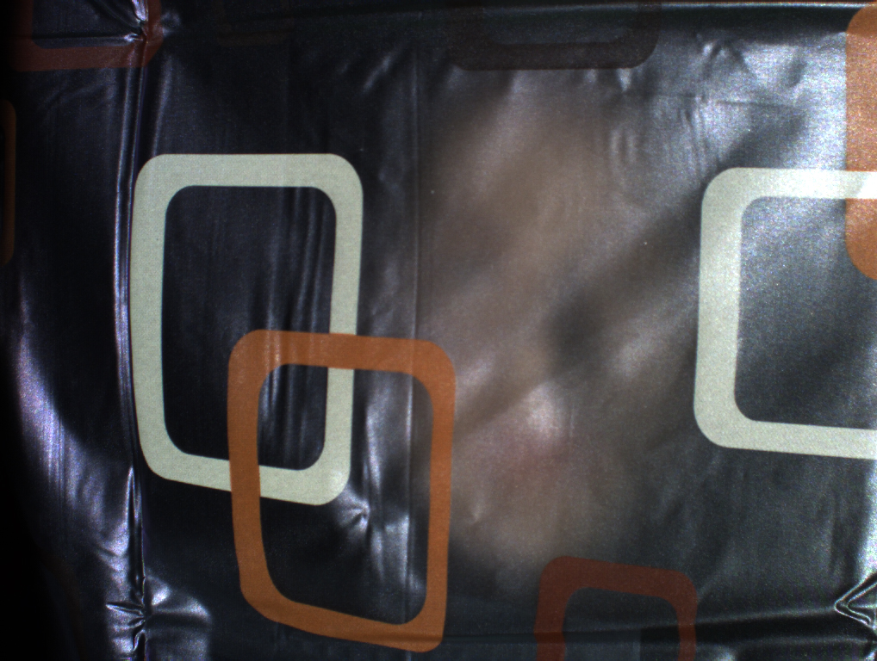
Translucent surfaces
Total illumination (normal image)

Slide 14
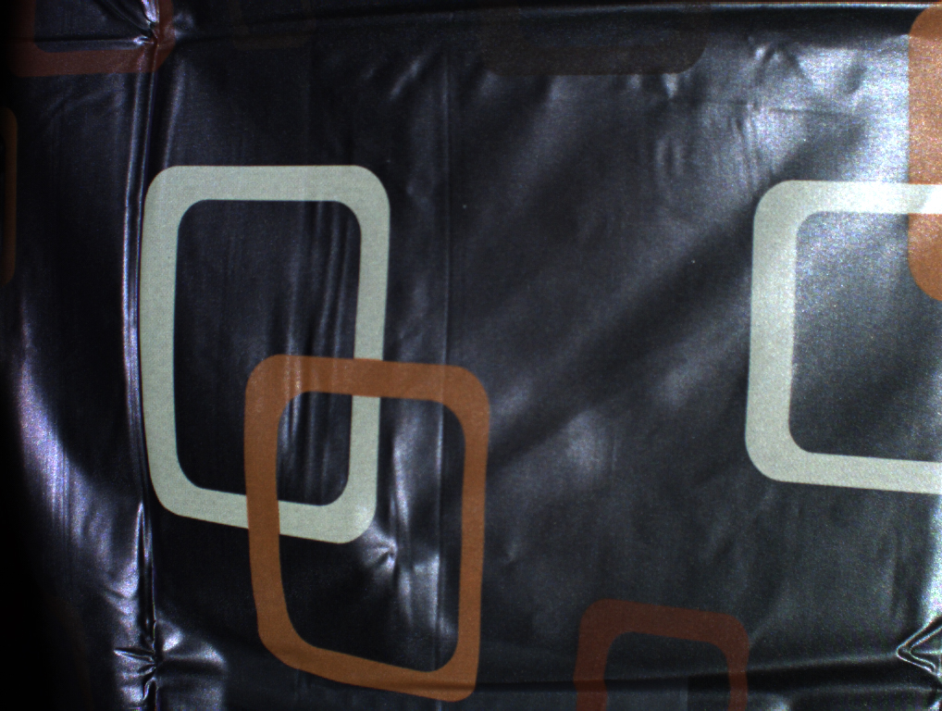
Translucent surfaces
Direct illumination

Slide 15
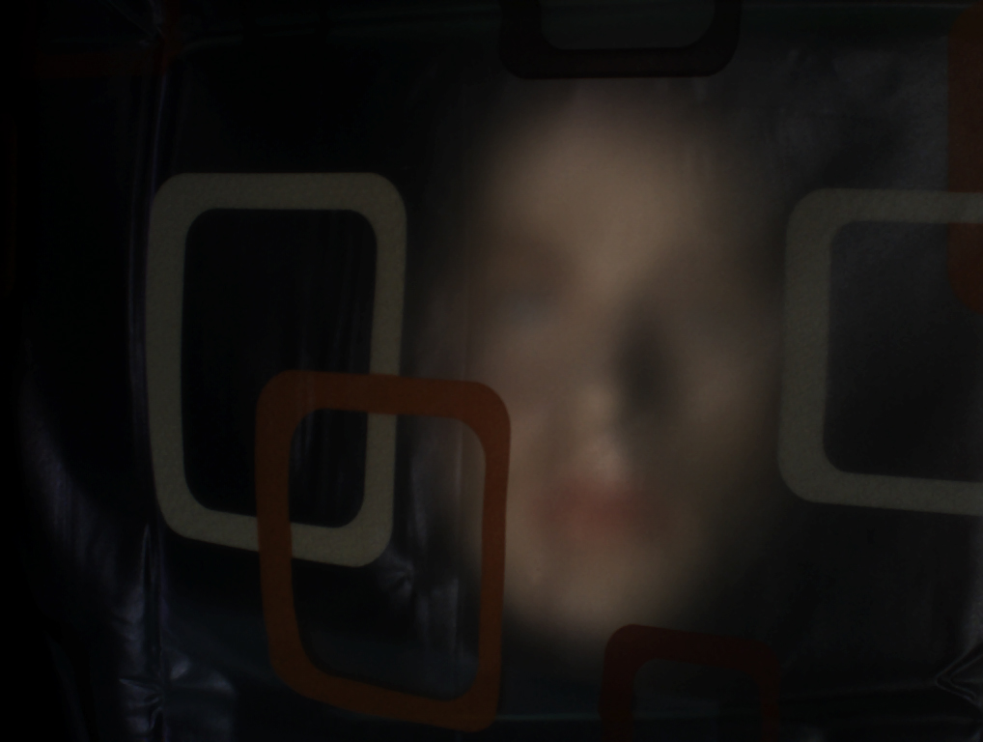
Translucent surfaces
Indirect illumination (translucent transmission)

Slide 16
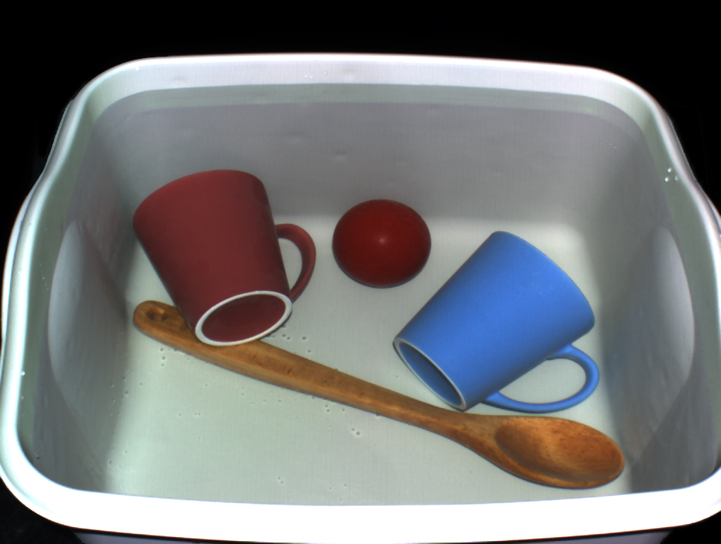
Tub of objects
Total illumination (normal image)

Slide 17
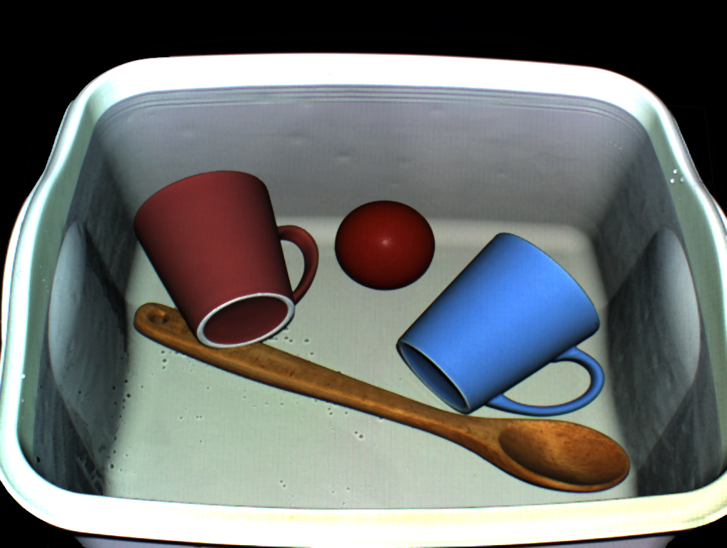
Tub of objects
Direct illumination (looks like OpenGL)

Slide 18
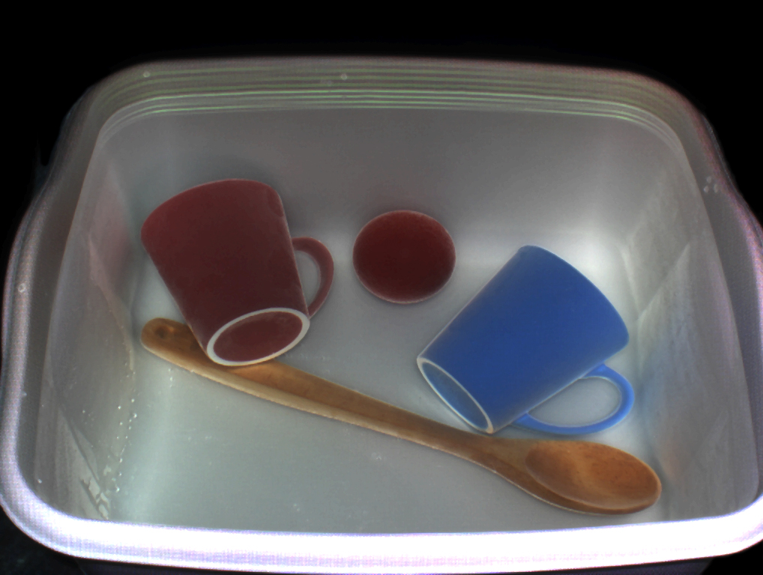
Tub of objects
Indirect illumination

Slide 19
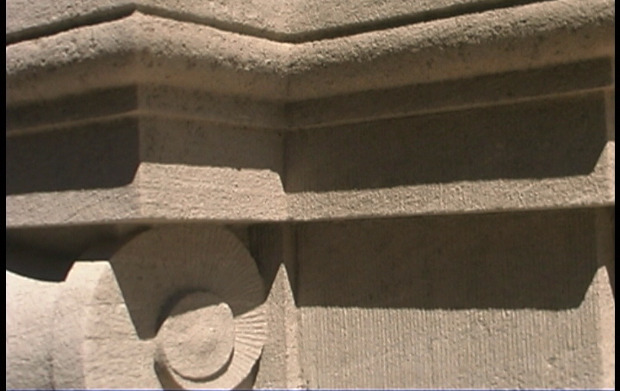
Outdoor environments
Total illumination (normal image)

Slide 20
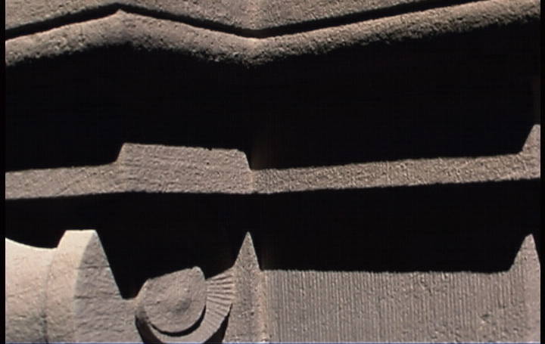
Outdoor environments
Direct illumination

Slide 21

Outdoor environments
Indirect illumination

Slide 22
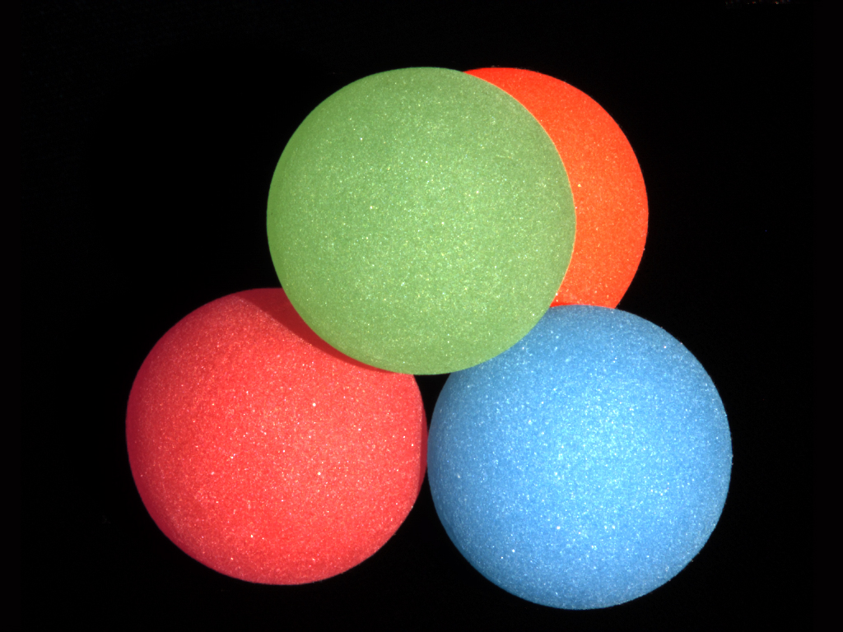
Subsurface scattering
Total illumination (normal image)

Slide 23
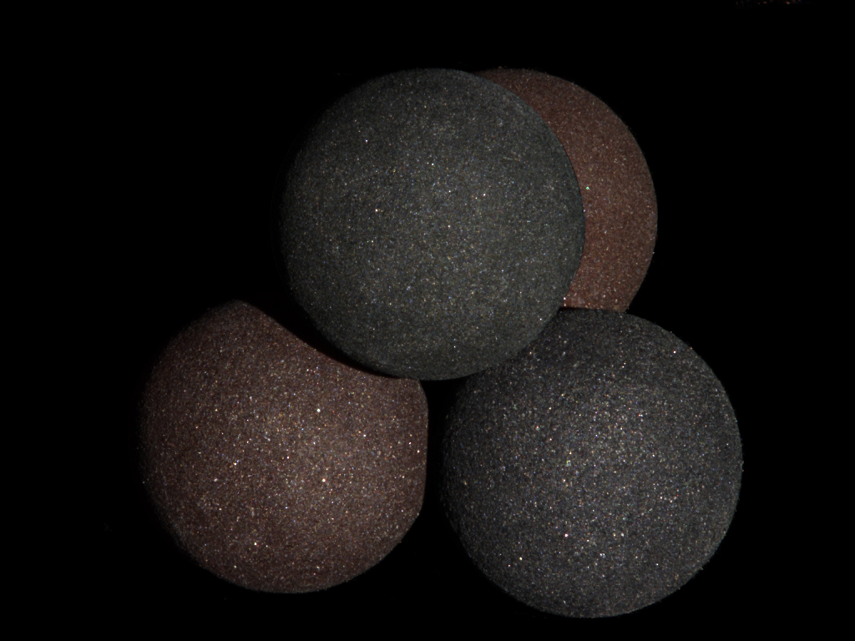
Subsurface scattering
Direct illumination

Slide 24
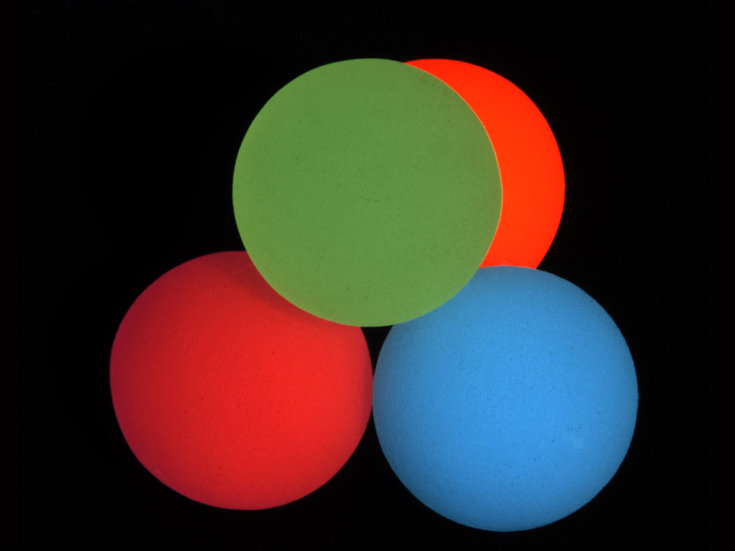
Subsurface scattering
Indirect illumination (subsurface scattering)

Slide 25
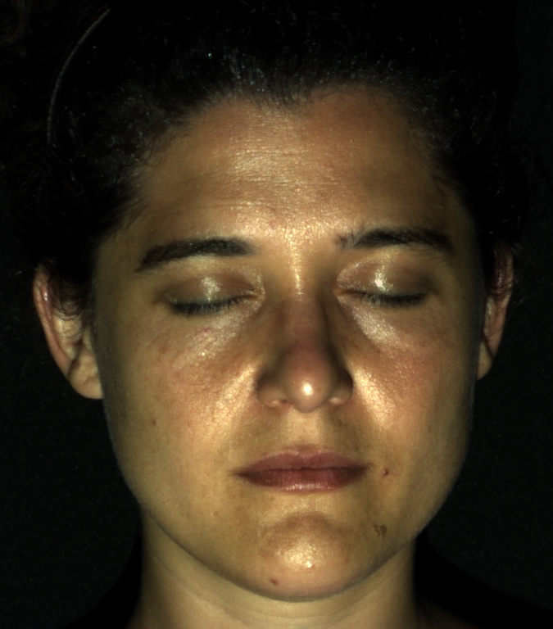
Human face
Total illumination (normal image)

Slide 26
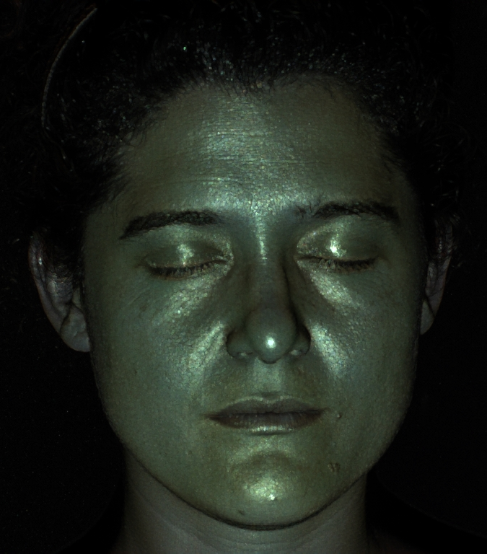
Human face
Direct illumination

Slide 27
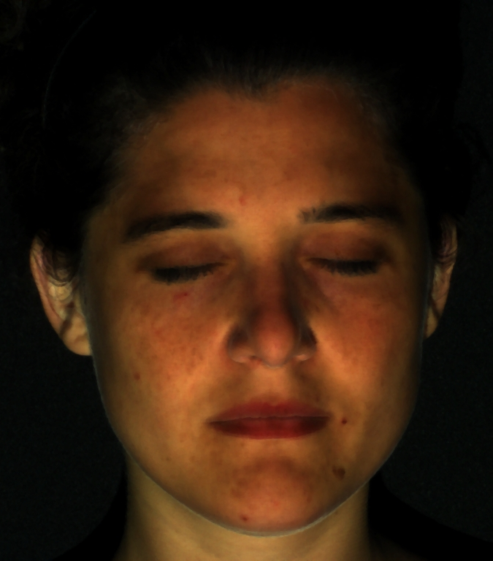
Human face
Indirect illumination

